Slide 1
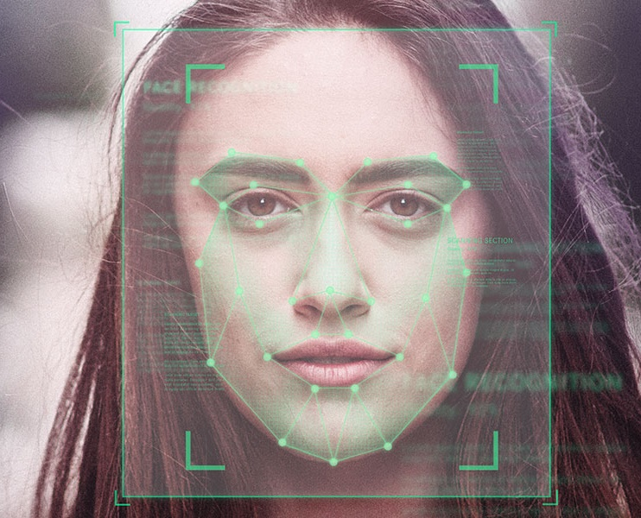
Face Attendance Checking System
Course: Artificial Intelligence in Control Engineering
Lecturer: Dr.Pham Viet Cuong
Group: 09

Slide 2
Content
Problem definition
Literature review
Implementation
Experimental results
Demo

Slide 3

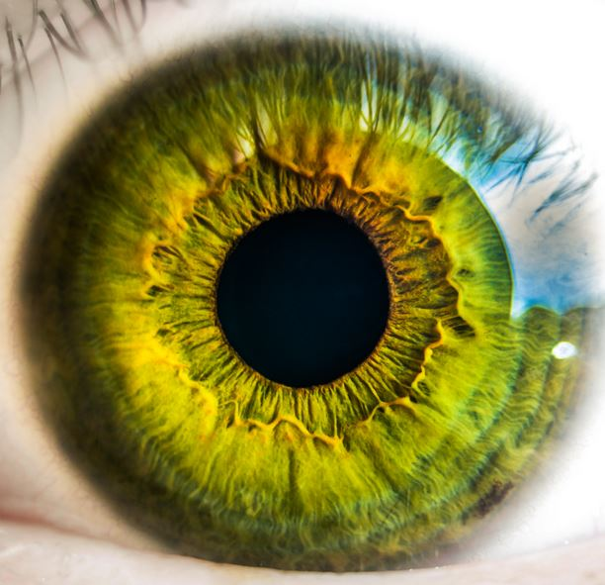

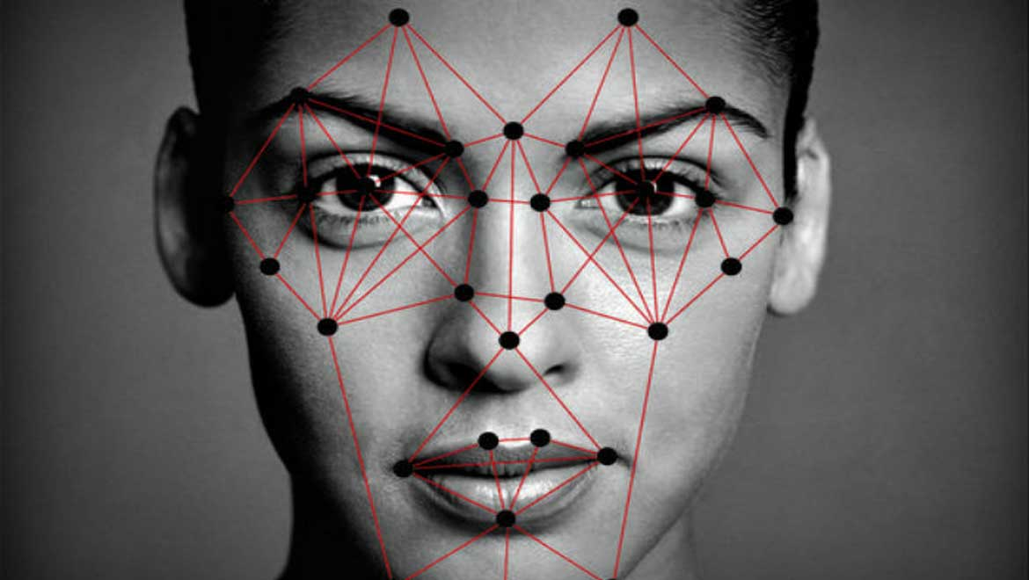

Problem definition

Slide 4
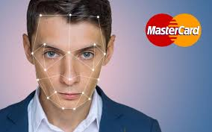
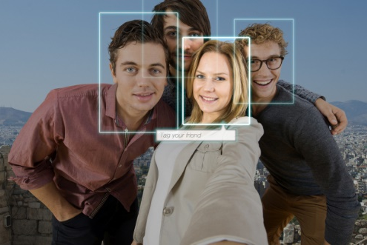
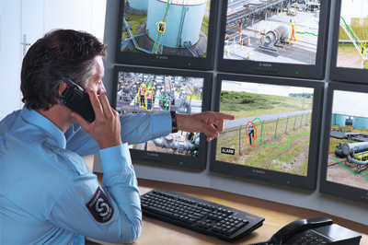
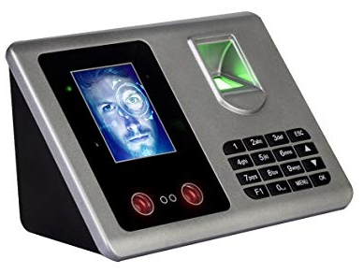
Problem definition

Slide 5
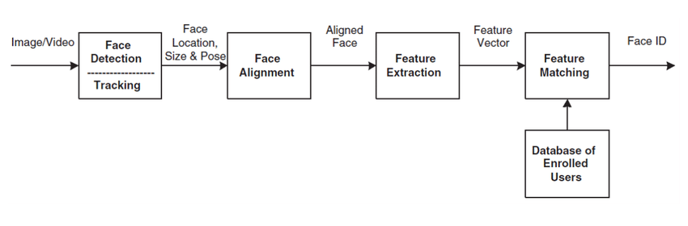
Problem definition

Slide 6
Members
https://github.com/AntiAegis/Face-Attendance-System

Slide 7
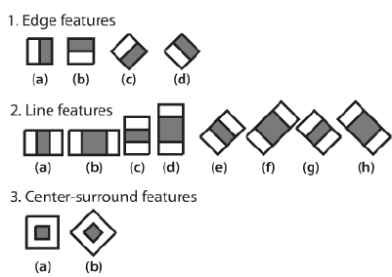
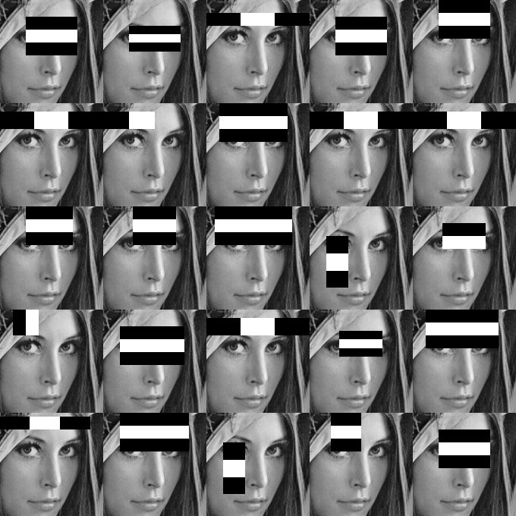
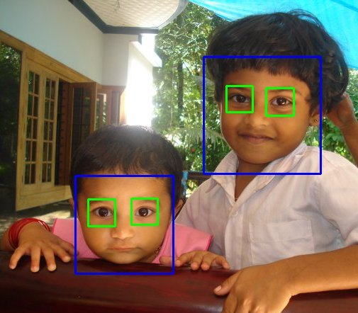
Literature review
A. Relative works
1. Face Detection and Alignment
The face detector proposed by Viola and Jones used Haar-Like features and AdaBoost algorithm to train cascaded classifiers

Slide 8
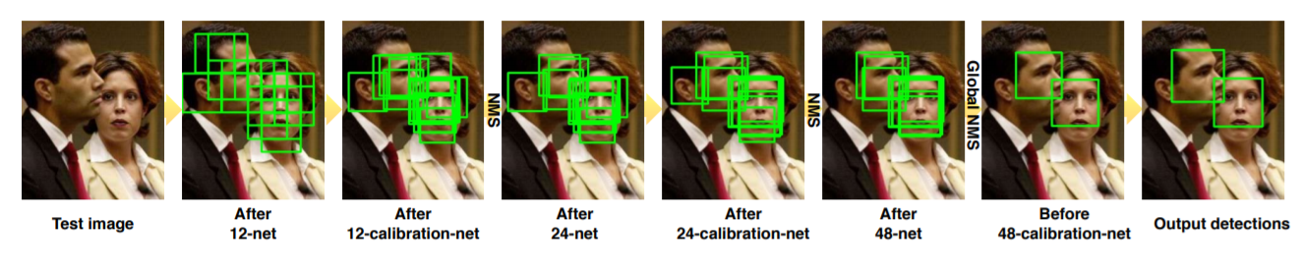
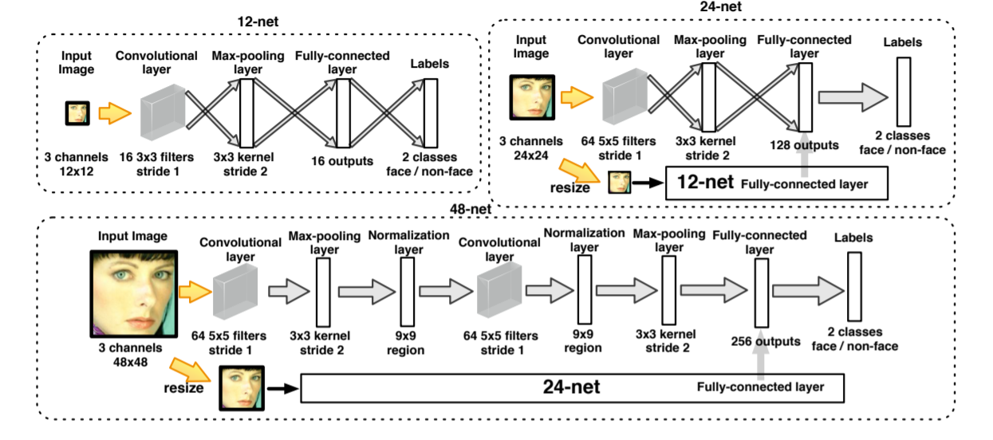
Literature review
A Convolutional Neural Network Cascade for Face Detection

Slide 9
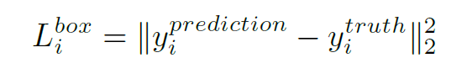
Literature review
Multi-task Convolutional Network
The learning objective is formulated as a regression problem, and the Euclidean loss:

Slide 10
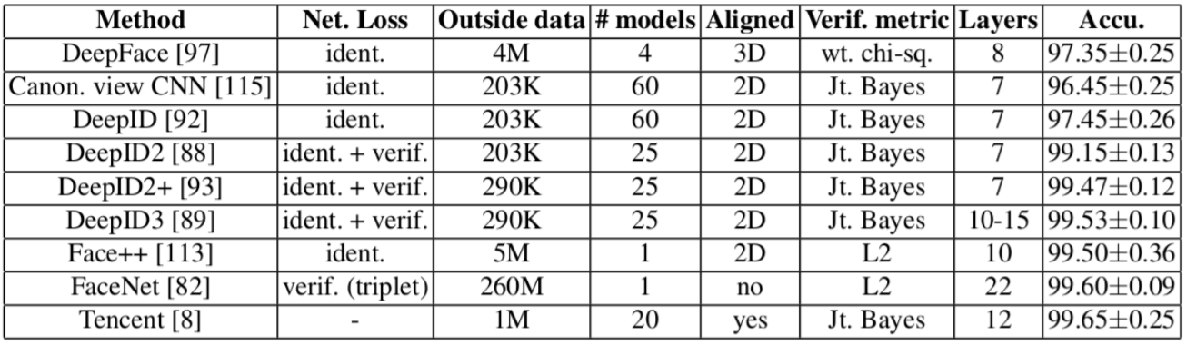
Literature review
A. Relative works
2. Face Recognition

Slide 11
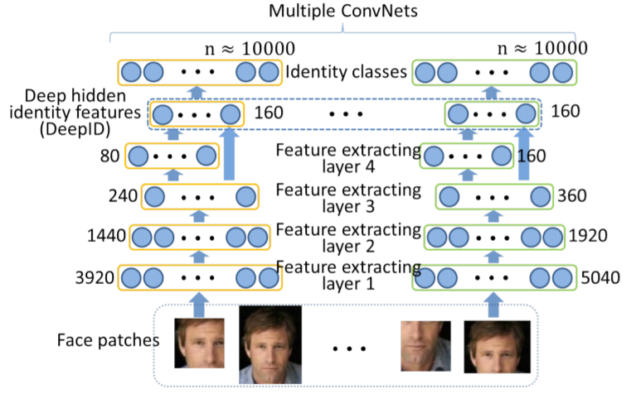
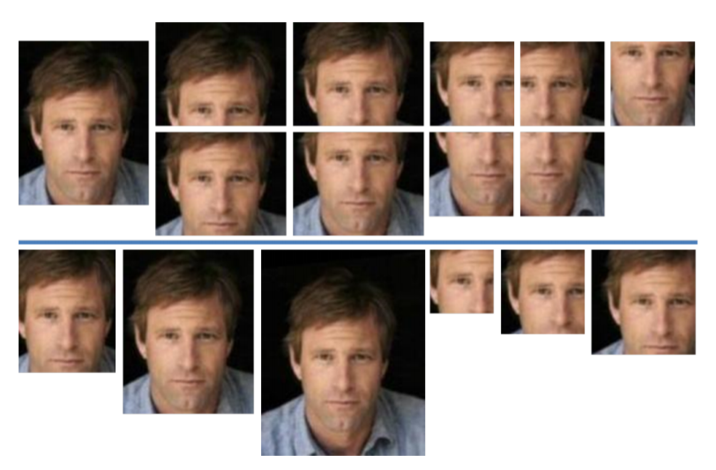
Literature review
Deep Learning Face Representation from Predicting 10,000 Classes (DeepID 1)
One CNN for a feature extractor. 60 CNNs in total.

Slide 12
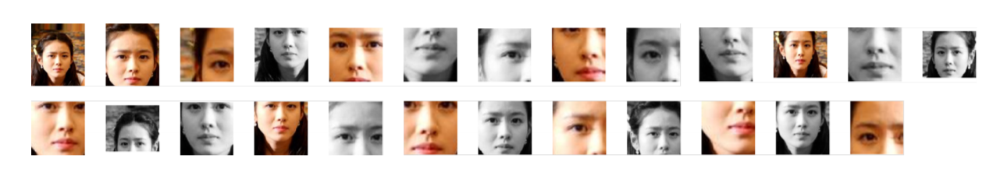
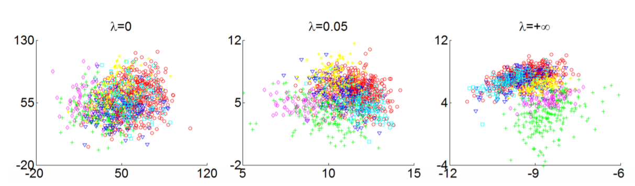
Literature review
DeepID 2 (NIPS 2014)
Patches selected for feature extraction

Slide 13
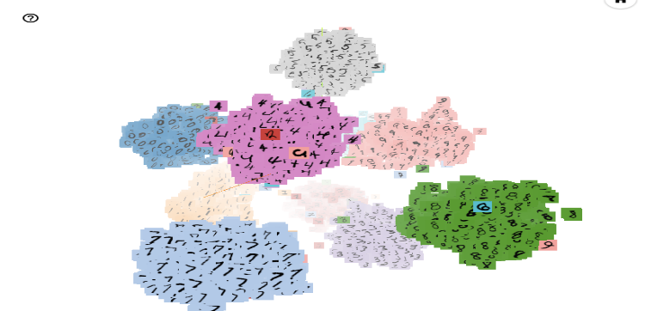
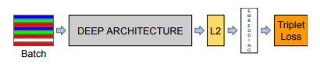
Literature review
FaceNet

Slide 14

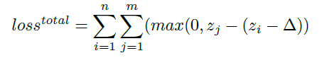
Literature review
B. Proposal Model

Slide 15
Implementation

Slide 16
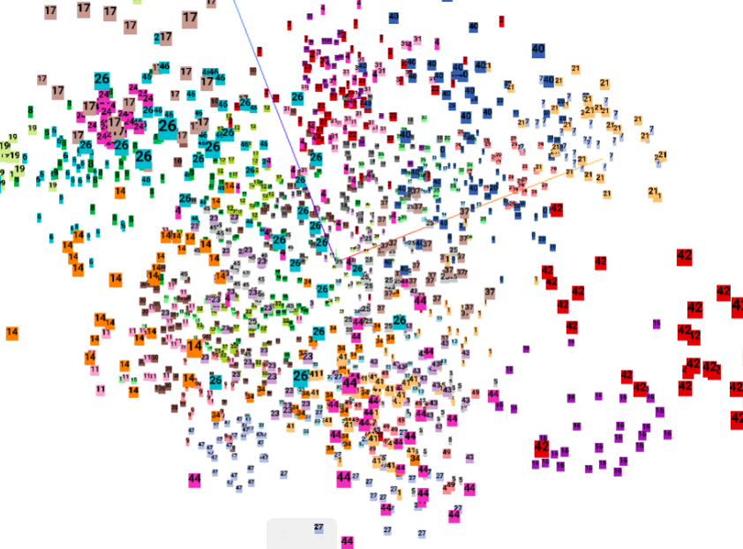
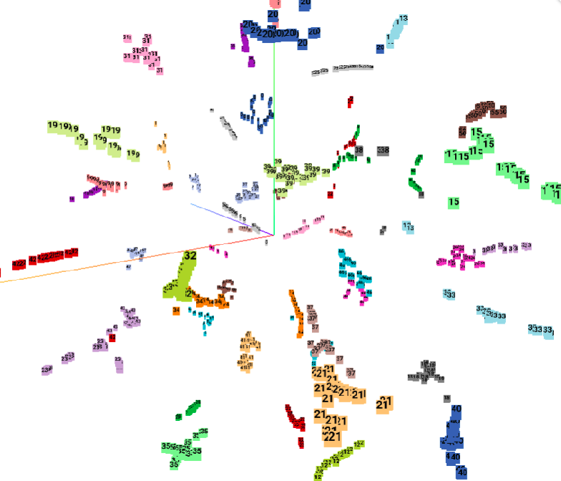
Experimental results
Visualization using PCA
Visualization using t-SNE

Slide 17
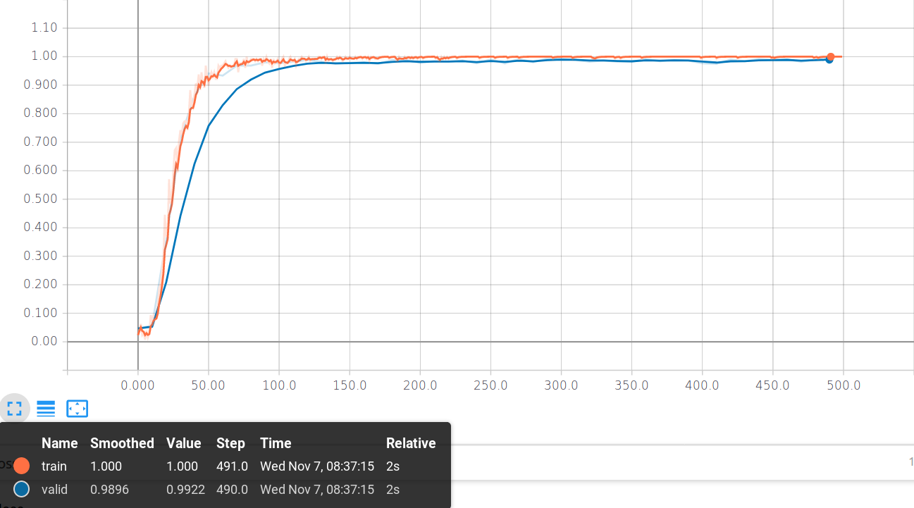
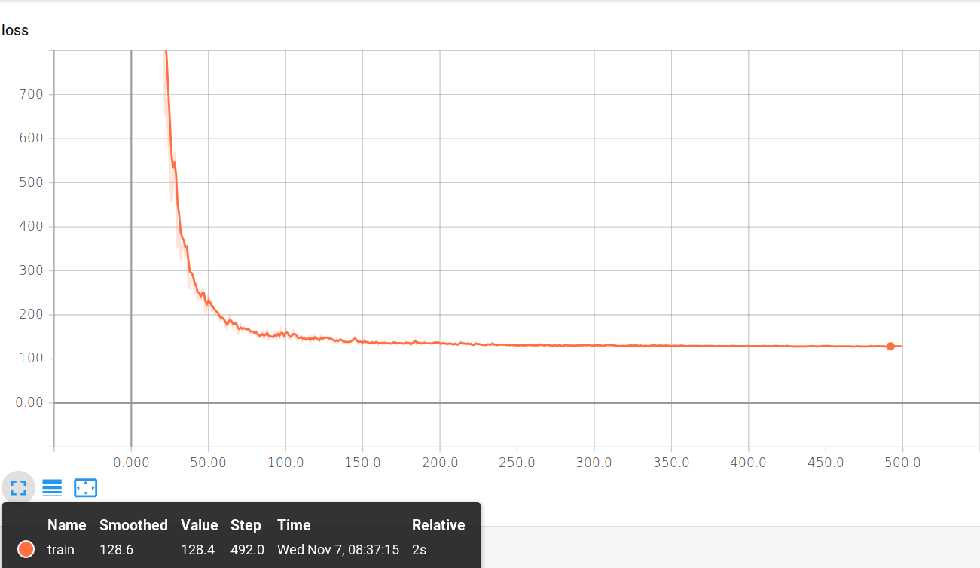
Experimental results

Slide 18
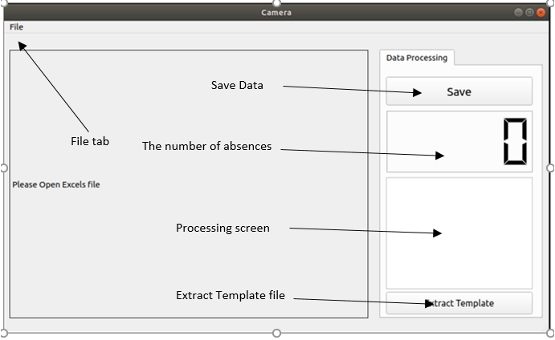
Experimental results

Slide 19
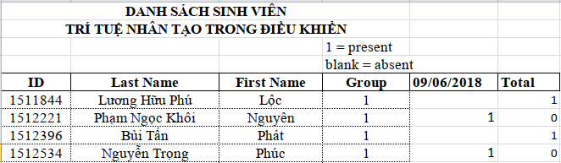

Experimental results

Slide 20
Demo

Slide 21
Conclusion

